Slide 1

21CSS101J-PROGRAMMING FOR PROBLEM SOLVING Unit II
SRM UNIVERSITY
Institute of Science and Technology,
Chennai

Slide 2
COURSE LEARNING RATIONALE (CLR) | The purpose of learning this course is to:
CLR-1: | Think and evolve with a logic to construct an algorithm and pseudocode that can be converted into a program
CLR-2 : | Utilize the appropriate operators and control statements to solve engineering problems
CLR-3 : | Store and retrieve data in a single and multidimensional array
CLR-4 : | Create custom designed functions to perform repetitive tasks in any application
CLR-5 : | Create basic Abstract Data Types with python
CLR-6 : | Create applications using suitable python library functions for solving datascience problems

Slide 3
Course Learning Outcomes (CLO) | At the end of this course, learners will be able
CLO-1: | To solve problems through computer programming. Express the basic data types and variables in C
CLO-2: | To use appropriate data types in simple data processing applications. To create programs using the concept of arrays
CLO-3: | To create string processing applications with single and multi-dimensional arrays
CLO-4: | To create user defined functions with required operations. To implement pointers in applications with dynamic memory requirements.
CLO-5: | To create programs using the python data types, loops, control statements for problem solving
CLO-6: | To implement the suitable python library based solutions for solving statistical problems in data science

Slide 4
Unit-2 Conditional Control -Statements :Simple if, if...else - Conditional Statements : else if and nested if - Conditional Statements : Switch case - Un-conditional Control Statements : break, continue, goto - Looping Control Statements:for, while, do..while - Looping Control Statements: nested for, nested while - Introduction to Arrays -One Dimensional (1D) Array Declaration and initialization - Accessing, Indexing and operations with 1D Arrays - Array Programs – 1D - Initializing and Accessing 2D Array, Array Programs – 2D - Pointer and address-of operators -Pointer Declaration and dereferencing, Void Pointers, Null pointers
Pointer based Array manipulation

Slide 5
Conditional Statements
User for making a decision and control according to given condition are used to Conditional Statements
Execution flow is changed based on the given condition
Conditional statements could have more than one conditions depending on the problem
Conditional Statements in C:
If .. Else… Statements
Switch Statements
Break and continue statements
Return statements
Go To Statements

Slide 6
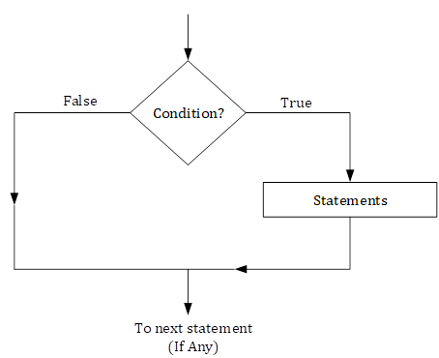
If … Else… Statement
Case I: if statement
Syntax:
if (condition / expression) {
Statements;
}
If the condition / expression is true, then statements are executed
If the condition / expression is false, then statements are not executed
Flow Chart:

Slide 7
If … Else… Statement -Cont’d
Example: To print the candidate is eligible for voting on getting their age
#include<stdio.h>
#include<conio.h>
void main(){
int age;
printf(“Enter your age:”);
scanf(“%d”, &age);
if(age >= 18) {
printf(“You are eligible for voting”);
}
}
Output:
Enter your age: 19
You are eligible for voting
Enter your age: 12

Slide 8
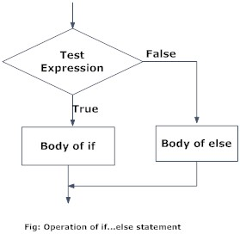
If … Else… Statement -Cont’d
Case II: If … Else … Statement, allows us to put some decision-making into our programs
If the condition is true then first statement execute otherwise second statement execute which is under the else condition
Syntax:
if (condition / expression) {
Statements1;}
else{
Statements2; }
If the condition is true (non zero), the statements1 will be executed. If the condition is false (0), the statements2 will be executed.
Flowchart:

Slide 9
If … Else… Statement -Cont’d
Example: To print the candidate is eligible for voting or not on getting their age
#include<stdio.h>
#include<conio.h>
void main(){
int age;
printf(“Enter your age:”);
scanf(“%d”, &age);
if(age >= 18) {
printf(“You are eligible for voting”);
}
else {
printf(“You are not eligible for voting”);
}
}
Output:
Enter your age: 19
You are eligible for voting
Enter your age: 12
You are not eligible for voting

Slide 10
If … Else… Statement -Cont’d
Case III: Nested if:
In the case of nested if else if the condition in the first statement is true then first if will be executed, if it is false , then the condition in the second if is checked.
If it is false as well , then the second else is executed.
Syntax:
if (condition1 / expression1) {
Statements1;}
else{
if (condition2 / expression2) {
Statements2;}
else{
Statements3; }
}

Slide 11
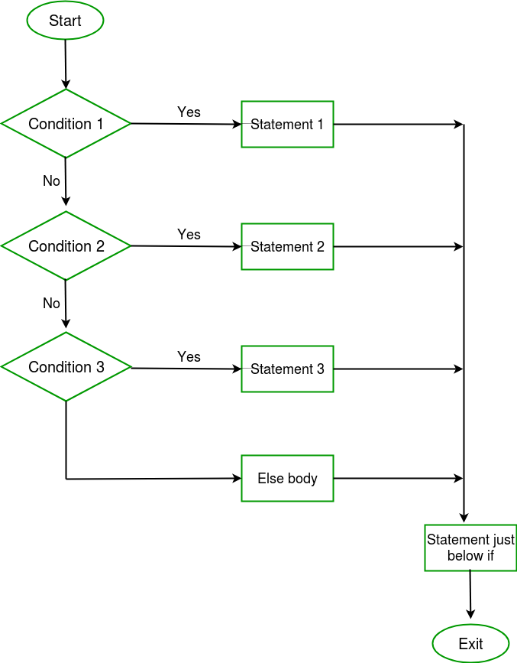
If … Else… Statement -Cont’d
Nested if Flowchart:

Slide 12
If … Else… Statement -Cont’d
Example: To print whether the given number is odd or even or not both
#include<stdio.h>
#include<conio.h>
void main(){
int i;
printf(“Enter a number:”);
scanf(“%d”, &i);
if(i == 0) {
printf(“Given number %d is neither even nor odd number.”, i);
}
else {
if( i % 2 == 0) {
printf(“Given number %d is even number.”, i);}
else {
printf (“Given number %d is odd number.”, i ) ; }
}
}
Output:
Enter a number: 0
Given number 0 is neither even nor odd number.
Enter a number: 2
Given number 2 is even number.
Enter a number: 5
Given number 5 is odd number.

Slide 13
If … Else… Statement -Cont’d
Case IV: if … else if … else …: The if elseif statement is useful when you need to check multiple conditions within the program, nesting of if-else blocks can be avoided using elseIf statement.
Syntax:
if (condition1 / expression1) {
Statements1;}
else if(condition2 / expression2){
Statements2;}
else{
Statements3; }
}

Slide 14
If … Else… Statement -Cont’d
Example: To print whether the given number is odd or even or not both
#include<stdio.h>
#include<conio.h>
void main(){
int i;
printf(“Enter a number:”);
scanf(“%d”, &i);
if(i == 0) {
printf(“Given number %d is neither even nor odd number.”, i);
}
else if( i % 2 == 0) {
printf(“Given number %d is even number.”, i);}
else {
printf (“Given number %d is odd number.”, i ) ;
}
}
Output:
Enter a number: 0
Given number 0 is neither even nor odd number.
Enter a number: 2
Given number 2 is even number.
Enter a number: 5
Given number 5 is odd number.

Slide 15
Switch Statement
The control statement that allows us to make a decision from the number of choices is called a switch or more correctly a switch – case – default , since these three keywords go together to make up the control statement.
Syntax:
Switch (expression)
{
Case constant1:
Statement;
Case constant2;
Statement;
Case constant3;
Statement;
Default:
Statement;
}

Slide 16
Switch Statement-Cont’d
Example: Print the number in textual format (for 0 to 9)
#include<stdio.h>
#include<conio.h>
void main(){
int i;
printf(“Enter a number:”);
scanf(“%d”, &i);
switch(i){
case 0: printf(“Zero”); break;
case 1: printf(“One”); break;
case 2: printf(“Two”); break;
case 3: printf(“Three”); break;
case 4: printf(“Four”); break;
case 5: printf(“Five”); break;
case 6: printf(“Six”); break;
case 7: printf(“Seven”); break;
case 8: printf(“Eight”); break;
case 9: printf(“Nine”); break;
}
}
Output:
Enter a number: 0
Zero
Enter a number: 6
Six

Slide 17
Loops in C – For Loop
Loop is used to repeat a block of code until the condition is true.
It is a repetition control structure that allows you to execute your expression a specific number of times.
The for loop is an important iteration technique in any programming language.
Syntax:
for (initialization; Test Condition; increment / decrement) {
statements;
}
Initialization: Variable for the loops are initialized with starting values
Test Condition: Conditional expression used to allow the execution of the loop
Increment / Decrement: The control variables in test condition are incremented or decremented in this statement

Slide 18
For Loop – Example
Example: Add the first n numbers
#include<stdio.h>
#include<conio.h>
int main(){
int n, sum, i;
sum = 0;
printf(“Enter a number”);
for(i = 0 ; i <= n; i++) {
sum += i;
}
printf(“The sum is %d”, sum);
}
Output:
Enter a number: 3
6

Slide 19
Nested For Loop
Syntax:
for (expr1; expr2; expr3){
Statement;
for (expr1;expr2;expr3){
statement
}
}

Slide 20
Nested For Loop – Contd
Example: Inverted half pyramid of *
include <stdio.h>
int main() {
int i, j, rows;
printf("Enter the number of rows: ");
scanf("%d", &rows);
for (i = rows; i >= 1; --i) {
for (j = 1; j <= i; ++j) {
printf("* ");
}
printf("\n");
}
return 0;
}
Output:
Enter the number of rows: 3
***
**
*

Slide 21
Nested For Loop – Contd
Example: Inverted full pyramid of *
#include <stdio.h>
int main() {
int rows, i, j, space;
printf("Enter the number of rows: ");
scanf("%d", &rows);
for (i = rows; i >= 1; --i) {
for (space = 0; space < rows - i; ++space)
printf(" ");
for (j = i; j <= 2 * i - 1; ++j)
printf("* ");
for (j = 0; j < i - 1; ++j)
printf("* ");
printf("\n");
}
return 0;
}
Output:
Enter the number of rows: 5
*****
****
***
**
*

Slide 22
While Loop
This loop is also known as pre-tested loop.
It allows us to executed your code many times depend on the situation / condition.
Syntax:
Variable intilization;
While (cond/expr){
Statement;
Incr/decr;
}

Slide 23
While Loop - Contd
Example: Add the first n numbers
#include<stdio.h>
#include<conio.h>
int main(){
int n, sum, i;
sum = 0;
printf(“Enter a number”);
i = 0 ;
while(i<= n){
sum += i ;
i++;
}
printf(“Sum is %d”, sum);
}
Output:
Enter a number 3
Sum is 6

Slide 24
do … while … - Loop
do … while … Loop is executed atleast once though the condition fails
Syntax:
Variable intilization;
do{
Statement;
Incr/decr;
} while (cond/expr);

Slide 25
do … while … Loop – Contd
Example: Add the first n numbers
#include<stdio.h>
#include<conio.h>
int main(){
int n, sum, i;
sum = 0;
printf(“Enter a number”);
i = 0 ;
do{
sum += i ;
i++;
} while(i<= n);
printf(“Sum is %d”, sum);
}
Output:
Enter a number 3
Sum is 6

Slide 26
do … while … Loop – Contd
Example: (Use Case)
#include<stdio.h>
#include<conio.h>
int main(){
int n, sum, i;
sum = 0;
n = 8
i = 9 ;
do{
sum += i ;
i++;
} while(i<= n);
printf(“Sum is %d”, sum);
}
Output:
Sum is 9

Slide 27
Break Statement
Break statement provides an early exit from for, while, and do, just as from switch.
A break causes the innermost enclosing loop or switch to be exited immediately.
The only way to exit this loop is through a break statement.

Slide 28
Break Statement – Contd
Example:
#include<stdio.h>
#include<conio.h>
void main(){
int p, q;
for (p = 1; p <= 10; p++ ){
if(p==7){
break;
}
printf(“Output is: %d”, p);
}
getch();
}
Output:
Output is : 1
Output is : 2
Output is : 3
Output is : 4
Output is : 5
Output is : 6

Slide 29
Goto
Goto Statement is a jump statement , it is used to transfer program control from one part of function / condition /loop etc to another.
This statement provide a facility to unconditional jump.
Example:
#include<stdio.h>
#include<conio.h>
void main(){
int p, q;
for (p = 1; p <= 10; p++ ){
if(p==7){
goto last;
}
last:
printf(“Output is: %d”, p);
}
getch();
}
Output:
Output is : 1
Output is : 2
Output is : 3
Output is : 4
Output is : 5
Output is : 6
Output is : 7
Output is : 8
Output is : 9
Output is : 10

Slide 30
Continue Statement
The continue statement passes control to the next iteration of the nearest enclosing do, for, or while statement in which it appears, bypassing any remaining statements in the do, for, or while statement body.
#include<stdio.h>
void main ()
{
int i = 0;
while(i!=10)
{
printf("%d", i);
continue;
i++;
}
}
Output:
Infinity loop

Slide 31
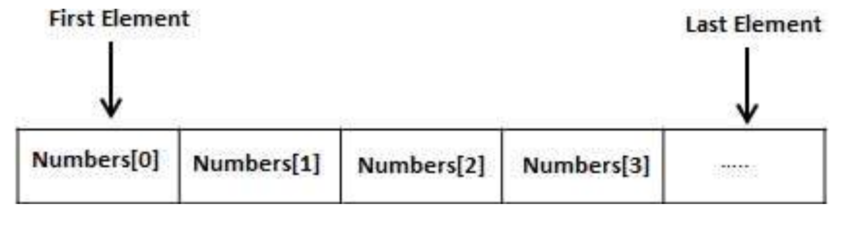
Array
An array is a collection of homogeneous elements which are sheltered under a common name.

Slide 32
Different Types of Arrays
1 – Dimensional Arrays
2 – Dimensional Arrays
Multidimensional Arrays

Slide 33
1 – Dimensional Arrays
One dimensional array have only one subscript under a common name.
Syntax:
Data_type array_name[array_size];
Example
int age[5]={2,4,34,3,4};

Slide 34
1 – Dimensional Arrays - Contd
#include<stdio.h>
int main(){
int a[4];
int i;
for ( i = 0; i < 4; i++ ){
Scanf(“%d”,&a[i]);
}
for ( i = 0; i < 4; i++ )
printf("a[%d] = %d\n", i , a[i]);
return 0;
}

Slide 35
2 – Dimensional Arrays
Two-dimensional array are those type of array, which has finite number of rows and finite number of columns
Syntax:
Data_type Array_name [row size][column size];

Slide 36
2 – Dimensional Arrays - Contd
Example: #include<stdio.h> int main() { int a[4][4], i , j; for (i = 0; i < 4; i++) { for ( j = 0; j < 4; j++) { a[i][j] = 0; scanf("a[%d][%d] ", i, j, a[i][j]); } } for (i = 0; i < 4; i++) { for ( j = 0; j < 4; j++) { a[i][j] = 0; printf("a[%d][%d] = %d \n", i, j, a[i][j]); } } return 0; }

Slide 37
Multi-dimensional arrays
An array have multiple subscript under a common name.
Syntax type name [size1][size2]…[sizeN];
Example float a[2][6][7][4]…[n];

Slide 38
Multi-dimensional arrays - Contd
Subscripted Variable Rules
Subscripted Variable can be double, integer or character.
The maximum number of subscripts is dictated by the compiler vendor. Twelve is common.
Arithmetic expressions may be used for subscripts.
Subscripts must be integer valued.
A statement must be included in your program which sets aside storage space (dimensions) for your arrays.

Slide 39
Multi-dimensional arrays - Contd
Example:
#include<stdio.h> int main() { int a[4][4][4], i , j,k; for (i = 0; i < 4; i++) { for ( j = 0; j < 4; j++) { for ( k = 0; k < 4; k++) { a[i][j][k] = 0; scanf("a[%d][%d][%d] ", i, j,k, a[i][j][k]); } } } for (i = 0; i < 4; i++) { for ( j = 0; j < 4; j++) { for ( k = 0; k < 4; k++) { a[i][j][k] = 0; printf("a[%d][%d][%d] = %d \n", i, j,k, a[i][j][k]); } } } }

Slide 40
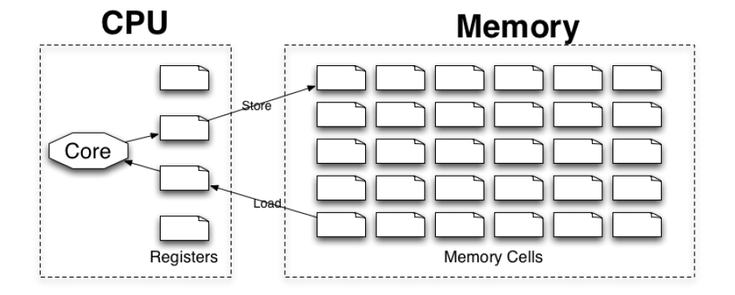
Need for Memory
CPU operates on data in a handful of registers
Not enough for most applications
Memory is vast collection of “value holders”
Values copied to/from registers

Slide 41
Memory needs to be organized
Must be able to locate previously stored value
Can‟t rely on actual value
Programmers see linear address space
Typical address space is vast
[S] 32bit or 64bit

Slide 42
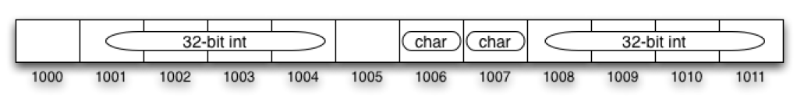
Large Values
Size of cell is limited
[S] e.g., 8 bits
Spread them in contiguous cells
Only need to know starting address and size

Slide 43
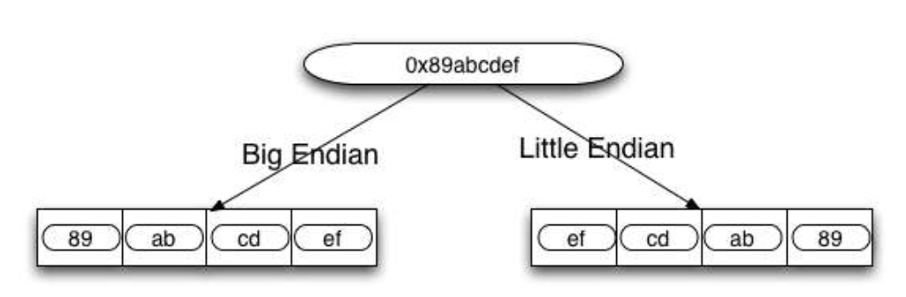
Large Values - Contd
Breakup of large values must be consistent with their reassembly
Where do we store the more-significant digits?

Slide 44
Virtual Memory
[S] Modern OSs provide different address space to each user program
Certain logical addresses mapped to physical addresses
Mechanism transparent
Overlapping addresses do not interfere
Not every address is mapped!

Slide 45
Variables
A symbolic name for a specific memory location
Can read and write contents
Guaranteed to exist every time it is used
Type used to interpret value
How many cells?

Slide 46
Automatic Variables
Declared at a beginning of a block
Lifetime and scope correspond to block

Slide 47
Allocating space for variables
Variables are allocated space on stack
Last-In-First-Out structure
Has a fixed base and grows “up” or “down”
Newer variables allocated “above” earlier
Newer variables “die” before older
Compiler may rearrange stack format within same function

Slide 48
Stack Example (In Function)

Slide 49
Stack Example (In Function) - Contd

Slide 50
Programe code and memory
Our program (“code”) is stored in memory
Every instruction has an address
Every function has an address
Most instructions are contiguous
[S] CPU aims IP at instruction in next cell

Slide 51
Function call
Copies of argument values pushed into stack
Return address pushed into stack
CPU IP aimed at beginning of function block

Slide 52
Function call - Contd

Slide 53
Returning from functions
All automatic variables of function are popped
Return address is popped
All passed arguments are popped
IP aimed at next instruction to execute in return statement
Return value in register or stack

Slide 54
Returning from functions - Contd

Slide 55
Swap function

Slide 56
Swap function - Contd

Slide 57
Swap function - Contd

Slide 58
Swap function - Contd

Slide 59
Pass-by-pointers
Functions always pass values by copying (pass-byvalue)
They return a single value by copying
Changes to arguments in invoked functions have NO IMPACT on corresponding variables in invoking function
To change, we must “break through” to earlier stack locations.
Solution:
Pass address of value holder represented by variable
Use that address to write directly into the value holder

Slide 60
Pointers
A pointer is a variable!
It has an address and stores a value
But the value can be interpreted as an address
X myX – declare variable of type X
X* pX – declare pointer to value of type X
How much space does a pointer occupy?

Slide 61
Assigning values to pointers
Arbitrary numeric values
Address of variables
Values of other pointers
[O] Address of functions
Cannot point at constants or temps

Slide 62
Dereferencing pointers
Accessing the pointed-to memory cell
If pX is pointer, (*pX) is the value
Can serve as an lvalue!

Slide 63
Implementing swap

Slide 64
Implementing swap - Contd

Slide 65
Implementing swap - Contd

Slide 66
Implementing swap - Contd

Slide 67
Caveat – Uninitialized pointers
Uninitialized pointers can contain junk
Dereferencing leads to random address
Data overwrites, segmentation faults, etc.

Slide 68
Caveat – NULL pointers
Pointers to NULL should not be dereferenced
Equivalent to accessing address 0
Access may result in “Bus Error” on UNIX

Slide 69
Caveats – Dangling references
Avoid returning references to automatic
Also don‟t keep pointers to vars in inner blocks
[PIC]

Slide 70
Casting pointers
Converting between pointer types is risky
Compiler will warn – Coercion possible

Slide 71
Void
Pointer type used to represent addresses without any type information
Shouldn‟t be dereferenced
Programmer responsible for coercion

Slide 72
Const pointers

Slide 73
Pointers to pointers

Slide 74
Pointers to pointers - Contd

Slide 75
Pointers to pointers - Contd

Slide 76
Pointers to pointers - Contd

Slide 77
Pointer Arithmetic
C permits addition/subtraction on pointers
Increments correspond to size of type value
Effective with contiguous set of variables

Slide 78
Pointers to array elements
Pointers can aim at address of array elements
Refer to other elements with pointer arithmetic

Slide 79
The array “Variable”
Array variable often treated as ptr to 1st element
Actually not a pointer
Computes into an rvalue for assignment to pointer
Passable to function that takes pointer or array
Not reassignable
Size of(ar) returns array size

Slide 80
Need for allocating memory
Size of data may not be known in advance
May depend on user input
e.g., Input N, then get N numbers, then present sorted
May depend on result of calculation
e.g., Given list of dated transactions, sort
Size may change over time
e.g., Increase canvas size in photoshop
e.g., Add more pages to word document
Basis for most data structures

Slide 81
Allocate memory
void *malloc(size_t size);
Submits request to allocate contiguous block of given size.
Size often specified as n*sizeof(type)
If failed, returns NULL
If valid, returns void pointer to new memory area
Programmer converts into pointer to first element
Pointer arithmetic or subscripts access rest of space
No bounds checking!
NULL otherwise

Slide 82
Allocated memory must be freed!
Programmer responsible for releasing dynamically allocated memory ASAP.
Use free() operation
void free(void *ptr);
System will know how much space to clear
Failure to free causes memory leak
free(ar);

Slide 83
Malloc/free example

Slide 84
Free () caveats
Once pointer to memory is lost, no way to free it
Do not release pointer to middle of allocated region

Slide 85
Free () caveats - Contd
Freeing the same memory twice
Freeing an automatic variable

